Slide 1
CASE STUDY – CREDIT CARD SEGMENTATION

Slide 2
Agenda
Business context, goal and approach
Data understanding
Exploratory Analysis
Data audit and preparation
Bivariate Analysis
Feature Engineering
K-Means Clustering
Profiling - Final cluster solution
Segment Characteristics
Key Observations
Predict on new data

Slide 3
Business problem
Business Context:
A credit card company has summarized the usage behavior data of about 9000 active credit card holders during the last 6 to 12 months. The business wants to define a market strategy to target promotions, campaigns etc. based on customer segmentation.
Business Goal:
The objective of this case study is to understand and create customer(active credit card holders) segments based on their behavioral usage of the credit card.
Approach:
Build customer profile with all relevant KPIs.
Identify relationships between services and their usage.
Apply data reduction techniques and a clustering algorithm to reveal the behavioral segments of credit card holders.
Identify cluster characteristics of the cluster using detailed profiling.

Slide 4
Data understanding
Data has been provided for 8950 active customers.
Detailed data dictionary has also been provided for understanding different variables in the data.
Total number of columns in the data set are 18. 17 numerical variables and 1 categorical.
Data types of the variables are: float64(14), int64(3), object(1).
Customer Id (CUST_ID) is the unique row level identifier for the data, data type is ‘object’.
From Pandas profiling report:
ONEOFF_PURCHASES is highly correlated with PURCHASES
PURCHASES is highly correlated with ONEOFF_PURCHASES
MINIMUM_PAYMENTS has 313 (3.5%) missing values
PRC_FULL_PAYMENT has 5903 (66.0%) zeros
CASH_ADVANCE has 4628 (51.7%) zeros Zeros
CASH_ADVANCE_FREQUENCY has 4628 (51.7%) zeros
CASH_ADVANCE_TRX has 4628 (51.7%) zeros

Slide 5
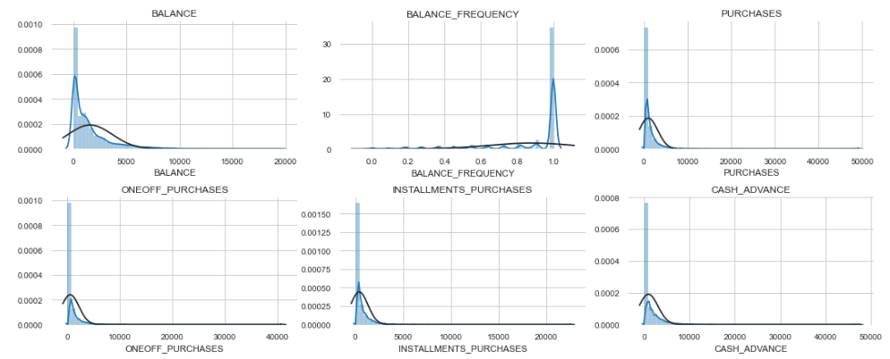
Exploratory Analysis

Slide 6
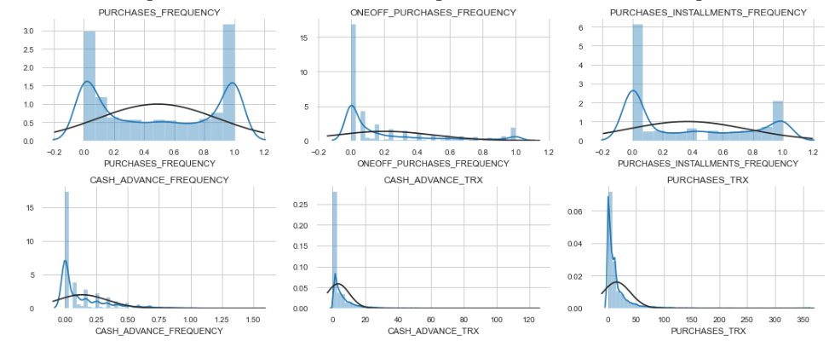
Exploratory Analysis

Slide 7
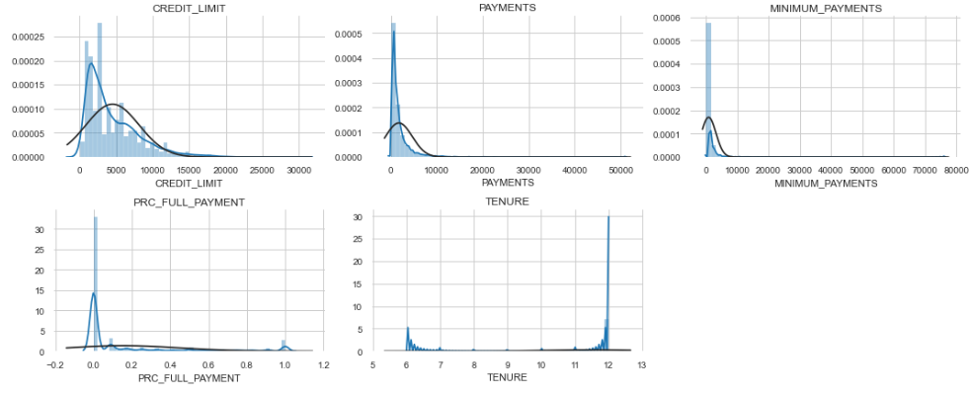
Exploratory Analysis

Slide 8
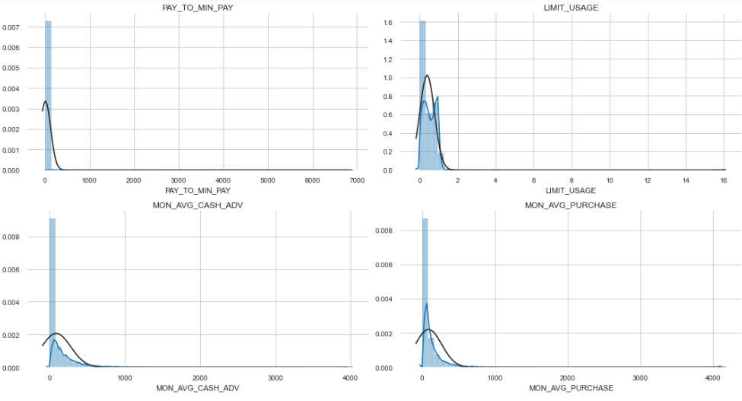
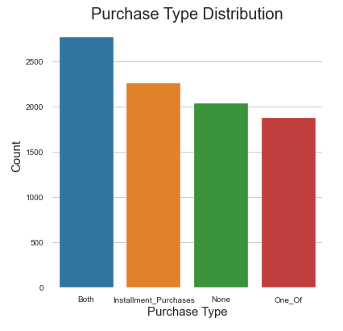
Exploratory Analysis

Slide 9
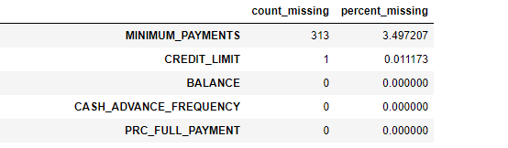
Data audit and preparation
Renaming columns appropriately – no name change is required
Check data types - Done
Check for missing values – Done
MINIMUM_PAYMENTS and CREDIT_LIMIT had missing values.
MINIMUM_PAYMENTS was imputed with the following criteria:
If PAYMENTS == 0 then imputed MINIMUM_PAYMENTS with 0
If PAYMNETS != 0 then impute MINIMUM_PAYMENTS with mean
CREDIT_LIMIT was imputed with mean.
Check for duplicates – no duplicates found
Any type conversion required - not required
Any special characters that need to removed/replaced – no special characters
Dropped CUST_ID as it is unique.

Slide 10
Data audit and preparation
Created all necessary KPIs:
Monthly average purchase, MON_AVG_PURCHASE = PURCHASES/TENURE
Cash advance amount, MON_AVG_CASH_ADV = CASH_ADVANCE/TENIURE
Purchase by type, PURCHASE_TYPE:
if ONEOFF_PURCHASES == 0 and INSTALLMENTS_PURCHASES == 0 then PURCHASE_TYPE = 'None’
if ONEOFF_PURCHASES > 0 and INSTALLMENTS_PURCHASES == 0 then PURCHASE_TYPE = 'One_Of’
if ONEOFF_PURCHASES == 0 and INSTALLMENTS_PURCHASES > 0 then PURCHASE_TYPE = 'Installment_Purchases’
if ONEOFF_PURCHASES > 0 and INSTALLMENTS_PURCHASES > 0 then PURCHASE_TYPE = 'Both’
Limit Usage, LIMIT_USAGE = BALANCE/CREDIT_LIMIT
Payment to Minimum Payment ration, PAY_TO_MIN_PAY = PAYMENTS/MINIMUM_PAYMENTS
Splitting the data into numerical and categorical variables, there were 21 numerical and 1 categorical variables(PURCHASE_TYPE).
Outliers were capped with floor and ceiling at 5th and 95th percentiles.
One hot encoding for categorical variable, PURCHASE_TYPE, was done.
Standardized the data with Scikit Learn’s StandardScaler.

Slide 11
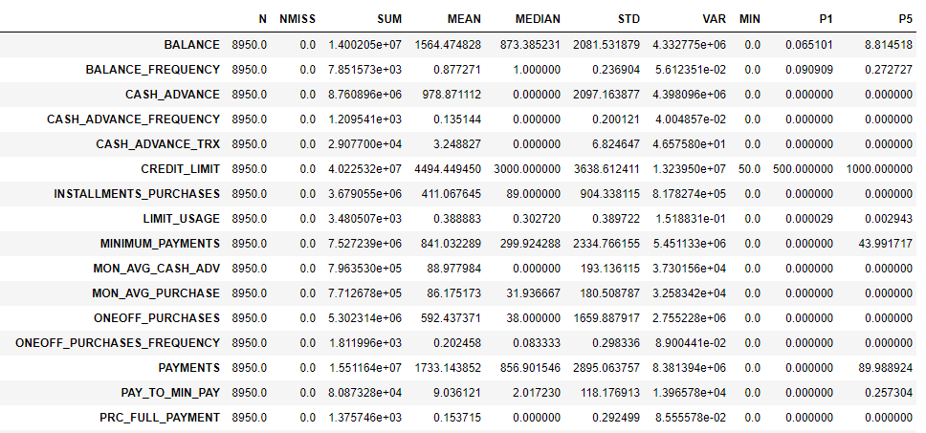
Data audit and preparation
Data Audit Report

Slide 12
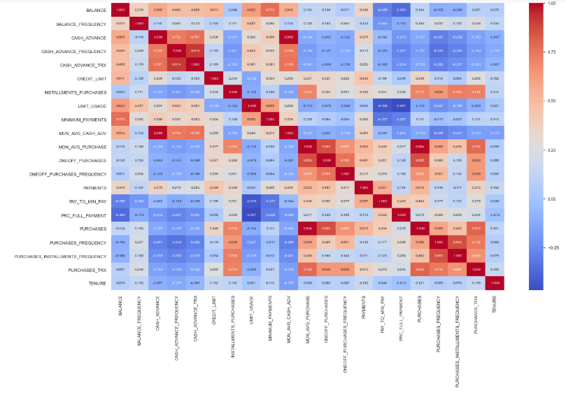
Bivariate Analysis
Based on the correlation matrix:
ONEOFF_PURCHASES is highly correlated with PURCHASES.
Also, PURCHASES_INSTALLMENTS_FREQUENCY shows high correlation with PURCHASES_FREQUENCY.
As expected, the derived KPI variables that we created show high correlation with the original variables.

Slide 13
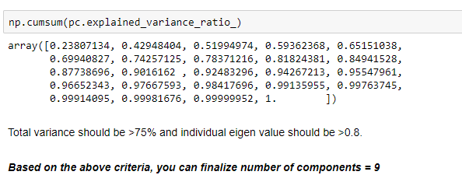
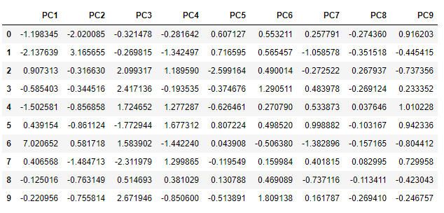
Feature Engineering
We used Principle Component Analysis to reduce the number of variables. Initially 24 principle components were built and then reduced to 9 based on explained variance and Eigen values.

Slide 14
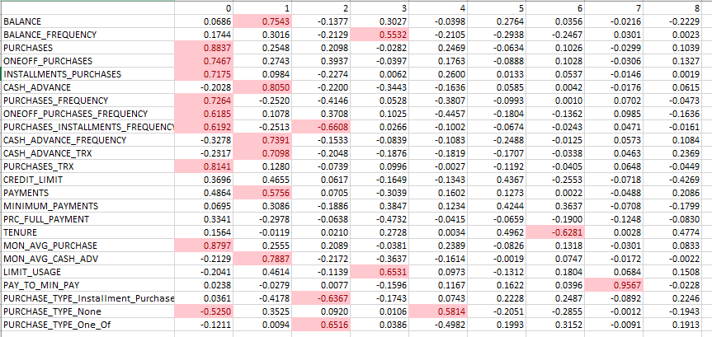
Feature Engineering
Loadings and Factor Analysis

Slide 15
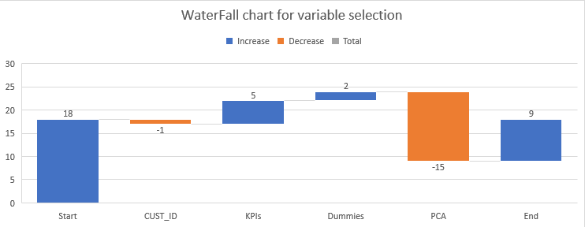
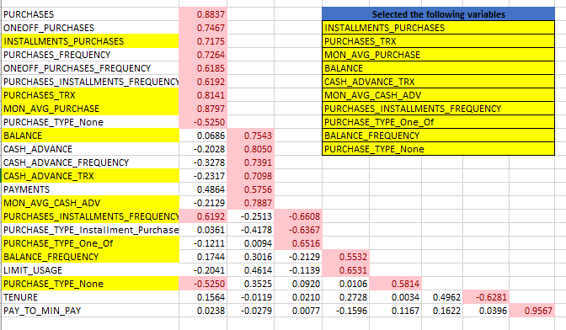
Feature Engineering
Dropped unique variable - CUST_ID
Added KPIs as derived variables
Added dummies for PURCHASE_TYPE
Variable reduction with PCA.
Finally, 9 variables were selected for K-Means model building.

Slide 16

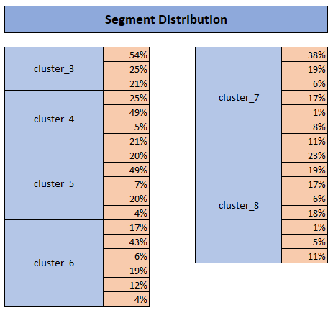
K-Means Clustering
We built 6 solution with 3, 4, 5, 6, 7, 8 clusters using K-Means model.
List of final variables for KMeans model:
INSTALLMENTS_PURCHASES
PURCHASES_TRX
MON_AVG_PURCHASE
BALANCE
MON_AVG_CASH_ADV
CASH_ADVANCE_TRX
PURCHASES_INSTALLMENTS_FREQUENCY
PURCHASE_TYPE_One_Of
BALANCE_FREQUENCY
PURCHASE_TYPE_None
From best practices perspective, all segments should have a distribution between 4% to 40%. Cluster solutions with 5 and 6 segments look promising. We would look at the Silhouette score.

Slide 17
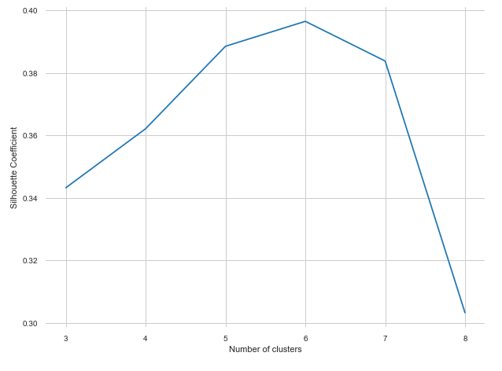
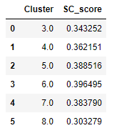
Silhouette score – Choose best cluster
Best SC score is for a 6 segment solution followed by 5 segment. We can look at a 5 or 6 segment solution. Segment distribution for 5 clusters looks a bit skewed as one of the segment is at 48%. Segment distribution for 6 cluster solution is better as lowest is at 4%, highest at 42%. The actual number of clusters chosen can be finally based on business context and profiling.

Slide 18
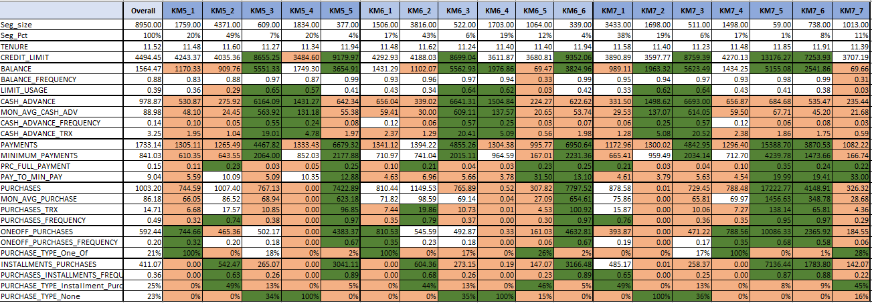
Profiling – final cluster solution
Looking at the profiling data, we choose 6 segment solution over 5 segment, as it has greater differentiation. Also, one of the segments in 5 segment solution has much higher distribution of 48%.

Slide 19
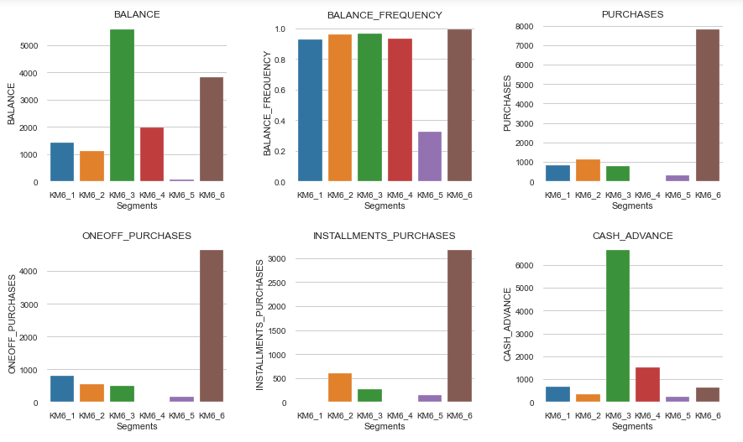
Profiling

Slide 20
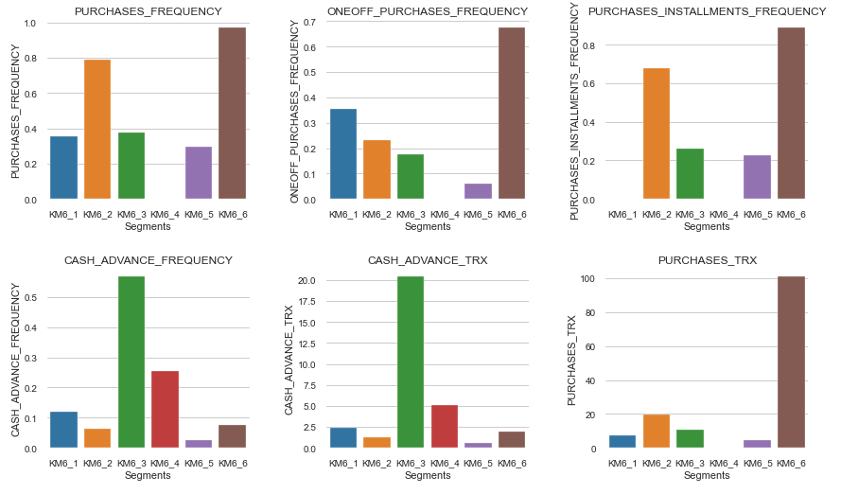
Profiling

Slide 21
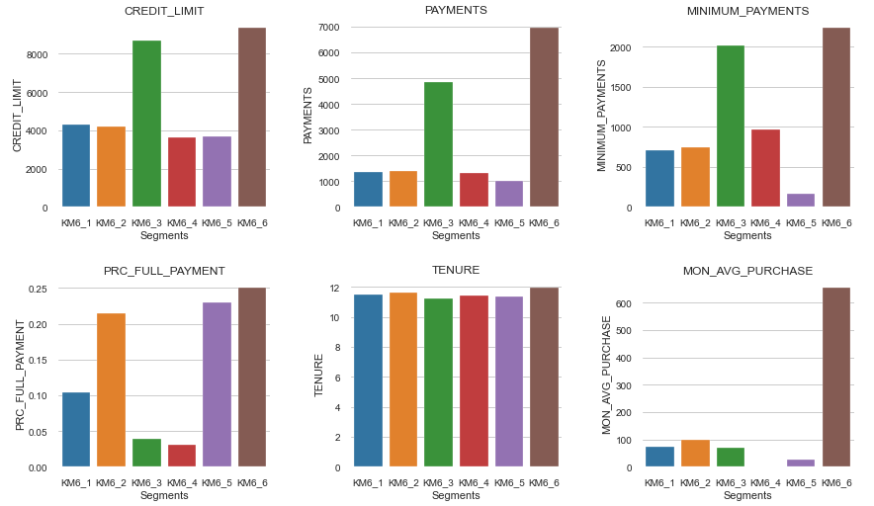
Profiling

Slide 22
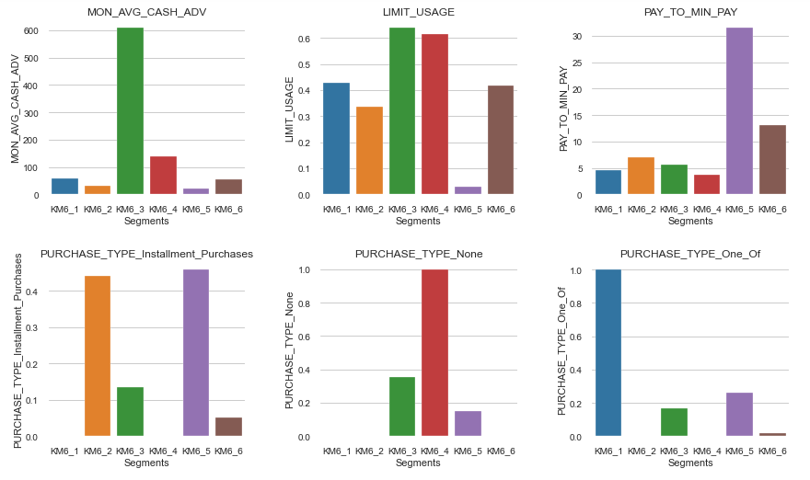
Profiling

Slide 23
Segment Characteristics
Segment 1
Total amount of instalment purchases zero for 1st segment.
Frequency of one-off-purchases high for segment 1.
Frequency of instalment purchases very low for 1st segment.
Purchases by type one-offs are highest for 1st segment.
Doesn't use much cash advance.
Spend is much below credit limit.
Segment 2
Total amount of instalment purchases high for segment 2.
Frequency of purchases very high for 2nd segment.
Frequency of one-off-purchases high for 2nd segment.
Frequency of instalment purchases very high for 2nd segment.
Purchases by type instalments is highest for 2nd segment.
Doesn't use much cash advance.
Spend is much below credit limit.
Full payments are quite high.
Purchase frequency is much high than segment 1.
Segment 3
Monthly average balance is highest for 3rd segment.
Total cash-advance amount is highest for 3rd segment.
Cash-Advance frequency highest for 3rd segment.
Average amount per cash-advance transaction highest for 3rd segment.
Total payments made second highest for 3rd segment.
Monthly average cash advance amount highest for 3rd segment.
Spend closer to credit limit.
Total minimum payments due in the period high for 3rd segment.

Slide 24
Segment Characteristics
Segment 4
Total purchase amount spent during last 12 months for 4th segment is zero.
Total amount of one-off purchases are zero for 4th segment.
Total amount of installment purchases zero for 4th segment.
Frequency of purchases zero for 4th segment.
Frequency of one-off-purchases for 4th segment is zero.
Frequency of installment purchases for 4th segment is zero.
Monthly average purchase lose to zero for 4th segment.
Spend closer to credit limit.
Total cash-advance amount is high for 4th segment.
Cash-Advance frequency is high for 4th segment.
Average amount per cash-advance transaction high for 4th segment.
Average amount per purchase transaction is close to zero.
Monthly average cash advance amount high for 4th segment.
Segment 5
Monthly average balance is lowest for 5th segment.
Ratio of last 12 months with balance very low for 5th segment.
Total amount of installment purchases high for segment 5.
Payments to minimum payments is highest for segment 5.
Frequency of one-off-purchases very low for 5th segment.
Total payments made very low for 5th segment.
Total minimum payments due in the period is low for 5th segment.
Monthly average purchase very low for 5th segment.
Payments to minimum payments ratio is highest for 5th segment.
Segment 6
Total purchase amount spent during last 12 months are highest for 6th segment.
Total amount of one-off purchases highest for 6th segment.
Total amount of installment purchases highest for 6th segment.
Total amount of installment purchases highest for 6th segment.
Frequency of one-off-purchases highest for 6th segment.
Frequency of installment purchases highest for 6th segment.
Average amount per purchase transaction highest for 6th segment.
Total payments made highest for 6th segment.
Monthly average purchase highest for 6th segment.
Frequency of purchases highest for 6th segment.
Total minimum payments due in the period highest for 6th segment.

Slide 25
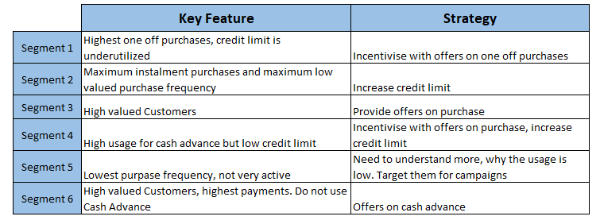
Key Observations
Segment 1 has relatively high balance and high cash advance but low payments and purchase frequency. Credit is under utilized.
Segment 2 is the largest group of customers with average credit limit but maximum purchase frequency and maximum instalment purchases. This group could be a target for credit limit increase.
Segment 3 is a small group of customers who use their cards primarily for cash advances but monthly purchase spent is also average.
Segment 4 only uses their cards for cash advances and have the lowest credit limit.
Segment 5 is a group of customers with lowest minimum payments, lowest purpose frequency. These are not very active customers.
Segment 6 is a small group of customer with highest average monthly purchase. Their payments are highest but they do not use their cards for cash advances.

Slide 26
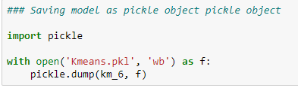
Predict on new data
For prediction on new data:
All data manipulation steps would apply as in this case study including missing treatment and outlier treatment.
All derived variable would need to be created.
All dummy variable creation steps would apply.
Test data would contain the finalized list of variables after the variable reduction steps.
INSTALLMENTS_PURCHASES
PURCHASES_TRX
MON_AVG_PURCHASE
BALANCE
MON_AVG_CASH_ADV
CASH_ADVANCE_TRX
PURCHASES_INSTALLMENTS_FREQUENCY
PURCHASE_TYPE_One_Of
BALANCE_FREQUENCY
PURCHASE_TYPE_None
KMeans 6 segment solution would be used.
Final model object was saved as a pickle object, this can be used.
Final models saved into pickle object would used.

Slide 27
Thank You !

